Slide 1
Keystone 2 IPC
Emphasis On Arm-DSP Communication

Slide 2
Agenda
Overview
IPC Methods
  Shared Memory
  Msgcom APIs
Shared Memory

Slide 3
MsgCom Library
Purpose: To exchange messages between a reader and writer.
Read/write applications can reside:
  On the same DSP core
  On different DSP cores
  On both the ARM and DSP core
Channel and Interrupt-based communication:
  Channel is defined by the reader (message destination) side
  Supports multiple writers (message sources)

Slide 4
Channel Types
Simple Queue Channels: Messages are placed directly into a destination hardware queue that is associated with a reader.
Virtual Channels: Multiple virtual channels are associated with the same hardware queue.
Queue DMA Channels: Messages are copied using infrastructure PKTDMA between the writer and the reader.
Proxy Queue Channels – Indirect channels work over BSD sockets; Enable communications between writer and reader that are not connected to the same Navigator.

Slide 5
Interrupt Types
No interrupt: Reader polls until a message arrives.
Direct Interrupt: Low-delay system; Special queues must be used.
Accumulated Interrupts: Special queues are used; Reader receives an interrupt when the number of messages crosses a defined threshold.

Slide 6
Blocking and Non-Blocking
Blocking: The Reader can be blocked until message is available.
Non-blocking: The Reader polls for a message. If there is no message, it continues execution.

Slide 7
Case 1: Generic Channel Communication
Zero Copy-based Constructions: Core-to-Core
NOTE: Logical function only
hCh=Find(“MyCh1”);
hCh = Create(“MyCh1”);
Reader
Writer
MyCh1
Tibuf *msg = PktLibAlloc(hHeap);
Put(hCh,msg);
Tibuf *msg =Get(hCh);
PktLibFree(msg);
Delete(hCh);
Reader creates a channel ahead of time with a given name (e.g., MyCh1).
When the Writer has information to write, it looks for the channel (find).
Writer asks for a buffer and writes the message into the buffer.
Writer does a “put” to the buffer. The Navigator does it – magic!
When the Reader calls “get,” it receives the message.
The Reader must “free” the message after it is done reading.
Notes:
Notes:
All naming is illustrative.
Open Items:
Recycling policies on Tx Completion queues
API Naming convention

Slide 8
Case 2: Low-Latency Channel Communication
Single and Virtual Channel
Zero Copy-based Construction: Core-to-Core
NOTE: Logical function only
Reader
Writer
hCh = Create(“MyCh2”);
MyCh2
Posts internal Sem and/or callback posts MySem;
hCh=Find(“MyCh2”);
chRx
(driver)
Get(hCh); or Pend(MySem);
Tibuf *msg = PktLibAlloc(hHeap);
Put(hCh,msg);
PktLibFree(msg);
hCh=Find(“MyCh3”);
MyCh3
hCh = Create(“MyCh3”);
Tibuf *msg = PktLibAlloc(hHeap);
Get(hCh); or Pend(MySem);
Put(hCh,msg);
PktLibFree(msg);
Reader creates a channel based on a pending queue. The channel is created ahead of time with a given name (e.g., MyCh2).
Reader waits for the message by pending on a (software) semaphore.
When Writer has information to write, it looks for the channel (find).
Writer asks for buffer and writes the message into the buffer.
Writer does a “put” to the buffer. The Navigator generates an interrupt . The ISR posts the semaphore to the correct channel.
The Reader starts processing the message.
Virtual channel structure enables usage of a single interrupt to post semaphore to one of many channels.
Notes:
Notes:
All naming is illustrative.
Open Items:
Recycling policies on Tx Completion queues
API Naming convention

Slide 9
Case 3: Reduce Context Switching
Zero Copy-based Constructions: Core-to-Core
NOTE: Logical function only
Reader
Writer
hCh = Create(“MyCh4”);
hCh=Find(“MyCh4”);
MyCh4
Tibuf *msg =Get(hCh);
Tibuf *msg = PktLibAlloc(hHeap);
chRx
(driver)
Put(hCh,msg);
Accumulator
PktLibFree(msg);
Delete(hCh);
Reader creates a channel based on an accumulator queue. The channel is created ahead of time with a given name (e.g., MyCh4).
When Writer has information to write, it looks for the channel (find).
Writer asks for buffer and writes the message into the buffer.
The writer put the buffer. The Navigator adds the message to an accumulator queue.
When the number of messages reaches a water mark, or after a pre-defined time out, the accumulator sends an interrupt to the core.
Reader starts processing the message and makes it “free” after it is done.
Notes:
Notes:
All naming is illustrative.
Open Items:
Recycling policies on Tx Completion queues
API Naming convention

Slide 10
Case 4: Generic Channel Communication
ARM-to-DSP Communications via Linux Kernel VirtQueue
NOTE: Logical function only
Reader
Writer
hCh = Create(“MyCh5”);
hCh=Find(“MyCh5”);
MyCh5
msg = PktLibAlloc(hHeap);
Tibuf *msg =Get(hCh);
Put(hCh,msg);
Tx
PKTDMA
Rx
PKTDMA
PktLibFree(msg);
Delete(hCh);
Reader creates a channel ahead of time with a given name (e.g., MyCh5).
When the Writer has information to write, it looks for the channel (find). The kernel is aware of the user space handle.
Writer asks for a buffer. The kernel dedicates a descriptor to the channel and provides the Writer with a pointer to a buffer that is associated with the descriptor. The Writer writes the message into the buffer.
Writer does a “put” to the buffer. The kernel pushes the descriptor into the right queue. The Navigator does a loopback (copies the descriptor data) and frees the Kernel queue. The Navigator loads the data into another descriptor and sends it to the appropriate core.
When the Reader calls “get,” it receives the message.
The Reader must “free” the message after it is done reading.
Notes:
Notes:
All naming is illustrative.
Open Items:
Recycling policies on Tx Completion queues
API Naming convention

Slide 11
Case 5: Low-Latency Channel Communication
ARM-to-DSP Communications via Linux Kernel VirtQueue
NOTE: Logical function only
hCh = Create(“MyCh6”);
Reader
Writer
MyCh6
hCh=Find(“MyCh6”);
chIRx
(driver)
Get(hCh); or Pend(MySem);
msg = PktLibAlloc(hHeap);
Put(hCh,msg);
Tx
PKTDMA
Rx
PKTDMA
PktLibFree(msg);
Delete(hCh);
PktLibFree(msg);
Reader creates a channel based on a pending queue. The channel is created ahead of time with a given name (e.g., MyCh6).
Reader waits for the message by pending on a (software) semaphore.
When Writer has information to write, it looks for the channel (find). The kernel space is aware of the handle.
Writer asks for buffer. The kernel dedicates a descriptor to the channel and provides the Writer with a pointer to a buffer that is associated with the descriptor. The Writer writes the message into the buffer.
Writer does a “put” to the buffer. The kernel pushes the descriptor into the right queue. The Navigator does a loopback (copies the descriptor data) and frees the Kernel queue. The Navigator loads the data into another descriptor, moves it to the right queue, and generates an interrupt. The ISR posts the semaphore to the correct channel
Reader starts processing the message.
Virtual channel structure enables usage of a single interrupt to post semaphore to one of many channels.
Notes:
Notes:
All naming is illustrative.
Open Items:
Recycling policies on Tx Completion queues
API Naming convention

Slide 12
Case 6: Reduce Context Switching
ARM-to-DSP Communications via Linux Kernel VirtQueue
NOTE: Logical function only
hCh=Find(“MyCh7”);
hCh = Create(“MyCh7”);
Reader
Writer
MyCh7
Msg = Get(hCh);
chRx
(driver)
msg = PktLibAlloc(hHeap);
Put(hCh,msg);
Tx
PKTDMA
Rx
PKTDMA
Accumulator
PktLibFree(msg);
Delete(hCh);
Reader creates a channel based on one of the accumulator queues. The channel is created ahead of time with a given name (e.g., MyCh7).
When Writer has information to write, it looks for the channel (find). The Kernel space is aware of the handle.
The Writer asks for a buffer. The kernel dedicates a descriptor to the channel and gives the Write a pointer to a buffer that is associated with the descriptor. The Writer writes the message into the buffer.
The Writer puts the buffer. The Kernel pushes the descriptor into the right queue. The Navigator does a loopback (copies the descriptor data) and frees the Kernel queue. Then the Navigator loads the data into another descriptor. Then the Navigator adds the message to an accumulator queue.
When the number of messages reaches a watermark, or after a pre-defined time out, the accumulator sends an interrupt to the core.
Reader starts processing the message and frees it after it is complete.
Notes:
Notes:
All naming is illustrative.
Open Items:
Recycling policies on Tx Completion queues
API Naming convention

Slide 13
Steps On ARM Side
Initialize Msgcom
Create a thread to run Agent Receive
Create thread to run writer/reader tasks
  Create/find channel
  Allocate and populate data buffer
  Msgcom_putMessage
  Wait for message to delete channel
    Delete channel
  Delete “named resource” on ARM side
  Use Agent to push deleted “named resource” to remote processor.

Slide 14
Steps On DSP Side
Call Ipc_start()
Initialize resource manager
Initialize and configure Qmss and Cppi
Initialize and configure shared heap
Initialize Msgcom
Initialize Agent and Agent Rx
Create Msgcom channel
Msgcom_getMessage
Invalidate message and get data buffer, then invalidate buffer
Free message
Delete Msgcom channel

Slide 15
ARM-DSP Necessities
Resource Manager
Packet Library
Job Scheduler
Agent

Slide 16
Resource Manager
Ensures that system resources can be requested and granted access without conflict. Throws an error during system initialization if requested resources are greater than system limitations.
Example system resources:
  General purpose queues
  Accumulator channels
  Hardware semaphores
  Direct Interrupt queues
  CPINTC Interrups
  Memory Region Requests

Slide 17
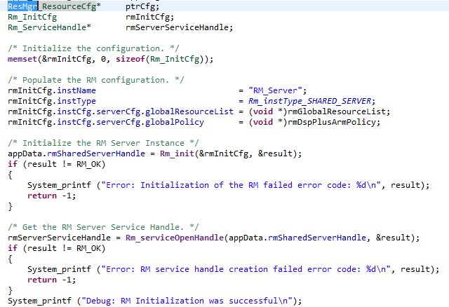
DSP Resource Manager Setup

Slide 18
Packet Library
Packet infrastructure implemented within Queue Manager Subsystem (QMSS)
High-level library to allocate packets and manipulate packets used by different types of channels
Enhance Heap manipulation

Slide 19
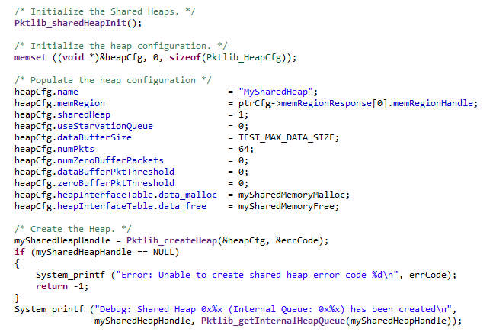
Heap Initialization PktLib

Slide 20
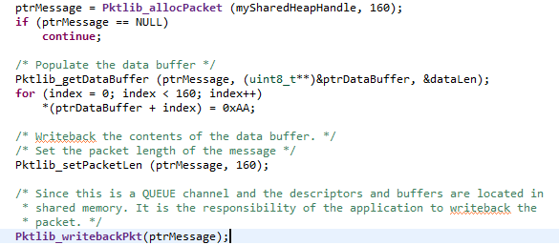
Packet Creation PktLib

Slide 21
Job Scheduler (JOSH)
Allows function call made on one processing element to be executed on another processing element
User application does not directly exercise any of the JOSH APIs

Slide 22
Agent
Module which implements remote procedure calls between the ARM and the DSP
Utilizes JOSH for function calls between the ARM and DSP
Each DSP core used requires an additional instance of Agent.

Slide 23
DSP Agent Creation
Agent has to be initialized on DSP before any remote function calls made
Agent initialization requires a shared memory address in DDR3
  Must reserve 4096 bytes of memory in DSP linker
Next, Agent must be created
Finally the Agent must be synced

Slide 24
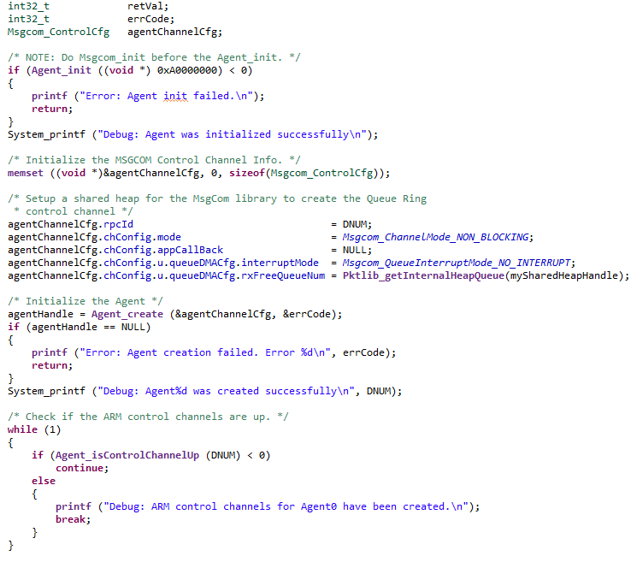
DSP Agent Rx Task Example

Slide 25
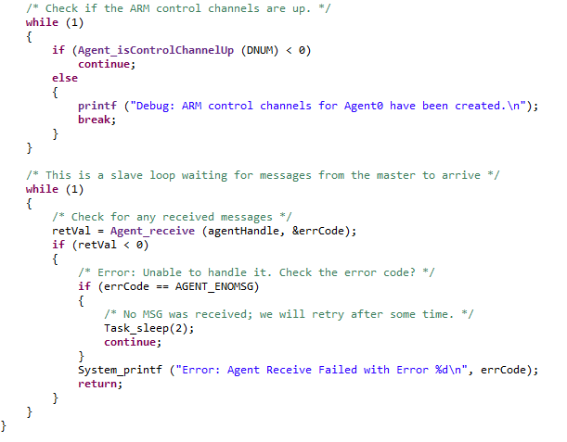
DSP Agent Rx Task Cont.

Slide 26
ARM Agent Init
ARM processes must register with MSGRouter app before they can utilize service
The configuration passed to the API includes:
  Local identifier which identifies ARM process
  Remote Identifier which is DSP core number to where all JOSH requests issued by ARM are sent to
  Default Process which indicates if the application will receive a JOSH request from a DSP core

Slide 27
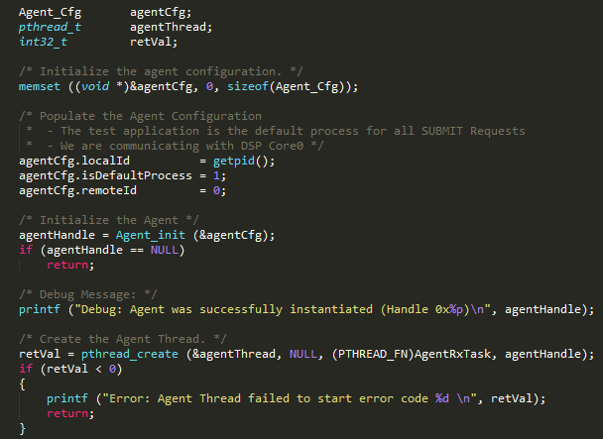
ARM Agent Init Code Example

Slide 28
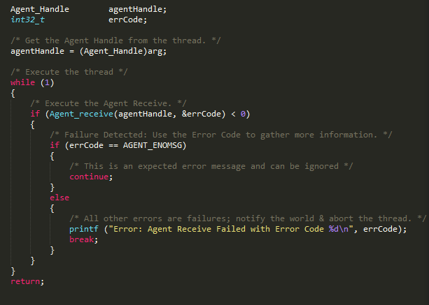
Agent Receive
The Agent receive API has to be called on both ARM and DSP to receive remote function call requests

Slide 29
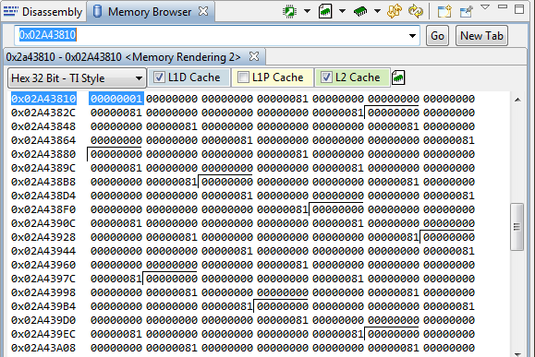
Debugging
Look up the channel database in Expressions window
Can find created channels and their corresponding queue numbers
Memory address for queue is 0x02A4 + QueueNum << 4
Place breakpoints at msgcom_getMessage and msgcom_putMessage and check this memory address to ensure packet is being put/gotten

Slide 30
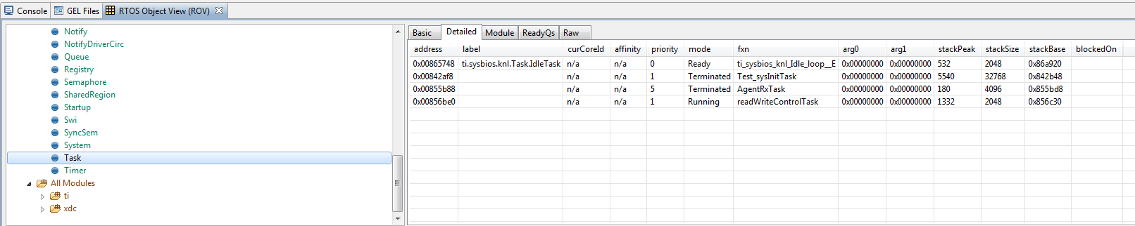
Debugging
Launch RTOS Object View (ROV) from Tools -> ROV
Select Task then click the “Detailed” tab
Helpful for seeing if put/get is pending on semaphore

